Slide 1


Tamper-Proof Digital Certificate Verification Using Blockchain and QR Authentication
Presented By:
KANIGASRI M(192565010)
CHAITHIKA L S(192311092)
BABY SHALINI E(192521268)
Course Code: CSA0925
Course Name: PROGRAMMING IN JAVA
Guided By:
Dr.Sivasankar

Slide 2
Introduction
Digital certificates are widely used to verify academic and professional achievements.
However, traditional paper and PDF certificates can be forged, duplicated, or modified, making verification difficult.
This project develops a Java-based certificate verification system that uses SHA-256 hashing, QR code authentication, and blockchain concepts to ensure secure certificate generation and instant verification.
The system provides a simple, reliable, and tamper-resistant solution for educational institutions and organizations.

Slide 3
Problem Statement & Objectives
Objectives
Prevent certificate forgery.
Secure certificate records using blockchain.
Enable instant QR code verification.
Detect certificate tampering.
Maintain transparent audit records.
Problem Statement
Fake certificates are increasing.
Manual verification is slow.
Certificates can be easily modified.
No reliable verification mechanism.

Slide 4
Module 1 – Certificate Generation
Description
This module allows the administrator to create digital certificates using student information. The application generates a unique SHA-256 hash and embeds a QR code into the certificate.
Process
Enter student details
Generate certificate
Create SHA-256 hash
Generate QR code
Save certificate as PDF
Output
Digital certificate
QR-enabled certificate

Slide 5
Module 2 – Certificate Verification
Description
Users scan the QR code to verify certificate authenticity. The Java application compares the stored hash with the current certificate hash.
Process
Scan QR code
Retrieve certificate data
Compare SHA-256 hashes
Validate certificate
Display verification status
Output
Certificate Verified
Certificate Invalid
Verification details

Slide 6
Module 3 – Admin & Audit Module
Description
The administrator manages certificate records and monitors verification history. The system records every verification attempt for auditing.
Process
Login as administrator
View issued certificates
Monitor verification logs
Detect modifications
Generate audit reports
Output
Audit logs
Verification history
Tampering alerts

Slide 7
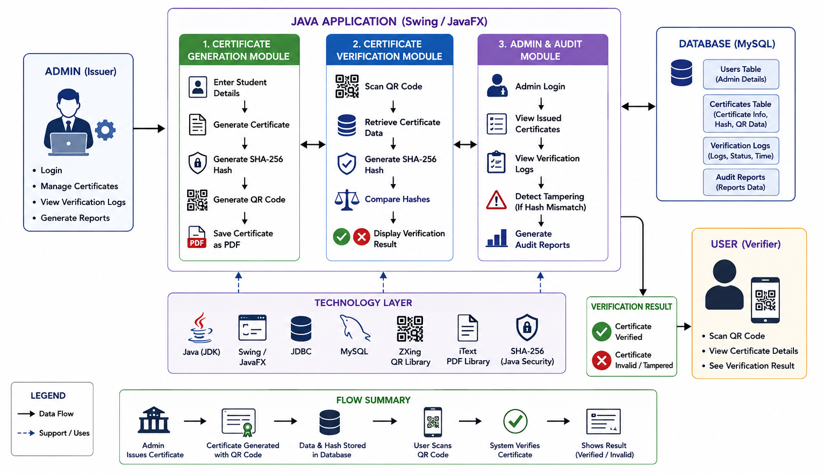
System Architecture

Slide 8
Technologies Used & Applications
Technologies Used
Java (JDK 17/21)
Java Swing / JavaFX
MySQL
JDBC
SHA-256 (Java Security API)
ZXing QR Code Library
iText PDF Library
Eclipse / IntelliJ IDEA
Applications
Colleges
Universities
Schools
Corporate Training
Online Certification
Government Documents

Slide 9
Conclusion
The proposed Java application provides a secure and efficient method for generating and verifying digital certificates.
By combining Java, MySQL, JDBC, SHA-256 hashing, and QR code technology, the system minimizes certificate forgery and simplifies the verification process.
It offers faster authentication, improved security, and easy certificate management.
The project demonstrates the practical application of Java programming in solving real-world security challenges and can be further enhanced with cloud integration and mobile-based verification.

Slide 10
References (2021–2025)
Oracle. (2024). Java Platform Documentation.
Oracle. (2023). Java Security API.
ZXing Team. (2024). ZXing QR Code Library Documentation.
iText Software. (2023). iText PDF Library Documentation.
Oracle. (2024). JDBC Developer Guide.

Slide 11
THANK YOU!!

Slide 12
